Slide 1
Romantic Music: Beethoven
Dr. Alan Haffa
Please Silence Cell Phones
See:

Slide 2
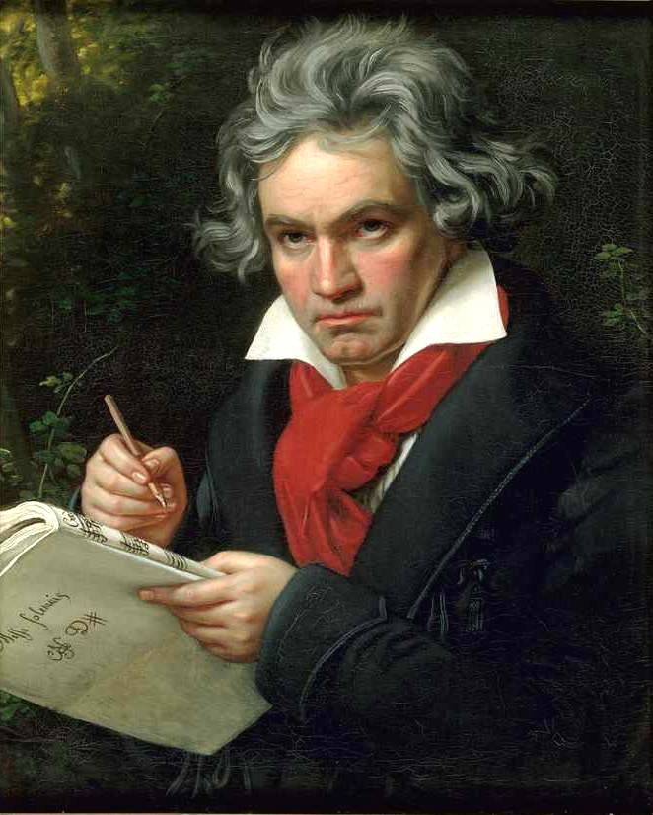
Ludwig von Beethoven (1770-1827)
Stirred by French Revolution and Napoleon
Transcended Classical into Romantic
Met Mozart and impressed him
Studied under Haydn
Deafness
Vienna under attack from Napoleon

Slide 3
ETA Hoffmann and Beethoven’s 5th Symphony
Music Critic
His review of the 5th Symphony in July, 1810
Describes Romantic Music
Music, unlike words, releases powerful passions that connect us to the infinite

Slide 4
Hoffman on Beethoven
“Thus does Beethoven’s instrumental music open up for us the realm of the monstrous and the immeasurable. Glowing rays shoot through the deep night of this realm, and we become aware of giant shadows that wave up and down, close us in more and more narrowly, and annihilate everything in us except for the pain of infinite yearning, in which every pleasure . . . sinks down and founders, and only in this pain, which, consuming within itself, but not destroying, love, hope, and joy, wants to burst open our breast with a full-voiced harmony of all passions, do we live on, enchanted spirit-seers [Geisterseher].” (quoted in Cassedy)

Slide 5
Beethoven as a Romantic
“Beethoven’s music sets in motion terror, fear, horror, pain and awakens the infinite yearning that is the essence of romanticism. Beethoven is a purely romantic (and therefore a truly musical) composer, and it may be for this reason that his vocal music, which does not allow for undetermined yearning but represents from the realm of the infinite only those emotions that are designated by means of words, is not successful and that his instrumental music rarely speaks to the multitude.” (Cassedy)

Slide 6
Hoffmann on the Closing of the Fifth Symphony
“Beethoven carries deep in his mind the romanticism of music, which he expresses in his works with high genius and clarity of vision [Besonnenheit]. The reviewer has never felt this in a livelier way than in the present symphony, which, in a climax that rises up to the very end, displays that romanticism of Beethoven more than any of his other works and irresistibly carries the listener away into the wondrous spirit realm of the infinite.”
http://www.youtube.com/watch?v=N6K_IuBsRM4

Slide 7
Summary of What Hoffmann heard that was Romantic
The purity of instrumental music
A sense of grandeur or simply grandness of scale
The presence of powerful and powerfully contrasting feelings, and
The elements of mystery, suspense, and surprise. (Cassedy)

Slide 8
Eroica (1803-1804)
Beethoven's Third Symphony, the Eroica, especially its second movement, "Marcia Funebre", is said to have engaged the public interest.
Controversy over the dedication
But there is no question that Beethoven admired Napoleon
He admired him not so much for battlefield exploits, as for his success as bringing political order to France (Clubbe 548)
Napoleon’s Energy, Passion, and ability to recreate the world inspired Beethoven.

Slide 9
Beethoven and Napoleon
John Clubbe argues that Beethoven imagined himself as his rival
After Napoleon’s exile to St. Helen in 1815, Beethoven may have seen himself as Napoleon’s successor.
Heroica dedicated to Napoleon in 1802. But after Napoleon declared himself Emperor in 1804, Beethoven was outraged.
“So he too is nothing more than a normal man.”
Published in 1806: “Heroic Symphony … composed to Celebrate the Memory of a Great Man.”

Slide 10
Why the Change in Dedication?
Austria had suffered a defeat at the hands of France in 1804
While Beethoven was not all that happy with life in Vienna, it would have been unacceptable in Vienna to publish with the dedication to Napoleon.
“Grand Man” is a compromise
Dedicating his work to Napoleon was not an attempt to flatter. It is a declaration of his own creative greatness—his equality with Napoleon. (Clubbe)
http://www.youtube.com/watch?v=tHvztnHOWEQ

Slide 11
“Emperor” Concerto, Opus 73, 1809
Written at the time of Napoleon’s occupation of Vienna
“With a courage and heroism of soul equal to Napoleon’s and with his chosen instrument, the piano, as protagonist, he would take the field against the Emperor. ..The general is Beethoven. What the Prussians had failed to accomplish by force of arms at Jena and the Austrians at Wagram, he would by the force of his music.“ (Cubbe 551)
http://www.youtube.com/watch?v=feIFi_HelfA

Slide 12
Ninth Symphony, 1824
“Ode to Joy” by Schiller, sung in last movement by Chorus
Incorporates Chorus and Symphony
Four Movements
Length is epic: Over One Hour. Difficulty of maintaining interest for so long with no extra-musical affects
Restless examination of various melodies suggests a soul-searching depth of passion

Slide 13
Schiller’s Poem
Joyous & Uplifting affirmation of Life: Man’s Harmony with Nature
International Brotherhood of Mankind
Lyrics: http://www.ca-in-sapporo.com/interests/beethoven.html
Music from Ode to Joy: http://www.youtube.com/watch?v=4pbMUEHvoAo

Slide 14
Summary
Passionate, individualistic, highly emotive
Expands complexity of Symphony
Heroic music captures the energy and passion inspired by Napoleon.
Beethoven wanted to do in music what Napoleon had done in politics and war.
9Th Symphony reflects the Universal aspiration of the Romantic Era: the Brotherhood of all Mankind

Slide 15
Bibliography
Cassedy, Steven. "Beethoven The Romantic: How E. T. A. Hoffmann Got It Right." Journal Of The History Of Ideas 71.1 (2010): 1-37. Academic Search Premier. Web. 5 Dec. 2011.
Clubbe, John. "The Creative Rivalry Of Beethoven With Napoleon." European Romantic Review 17.5 (2006): 543-558. Academic Search Premier. Web. 5 Dec. 2011.
Knight, Frida. Beethoven and the Age of Revolution. New York: International Publishers, 1973.
Steblin, Rita. "Who Died? The Funeral March In Beethoven's Eroica Symphony." Musical Quarterly 89.1 (2006): 62-7979. Academic Search Premier. Web. 5 Dec. 2011.

